Slide 1
In-depth study of Underlying Decisive Factors and Mechanisms for Electrochemical Nitrogen Reduction of Designed ReS2- based Single-Atom Catalysts

Slide 2
Here we specifically select ReS₂ with and without S-vacancy as a TM supporting substrate for electrochemical NRR. A database containing 40 SAC@ReS₂ materials with 27 reaction steps in each compound was generated by DFT calculations. Then, we indeed find strongly underlying decisive factors relations between predicted overpotentials, and four machine learning algorithms were employed to predict the novel mechanisms of catalytic NRR on SACs@ReS₂ with and without S-vacancy. We systematically evaluate the catalytic activity by studying the scaling relations of Eb(N) vs Eb(N2H) and Eb(N) vs Eb(NH2), Ta, Mo, Os, and Ir SACs embedded into ReS2 are selected out as promising SACs for NRR. Finally, by comparing the potential determining step and limiting potential of above SACs, Ta and Mo are highlighted for NRR with a relatively low negative limiting potential of −0.41 and -0.45eV respectively through the altenating mechanism. Furthermore, electronic structure analysis shows it to be a consequence of charge transfer to the ReS2 substrate, which selectively weakens the otherwise strong TM1−N bonds for the earlier TM. While earlier TMs (like Ta or W) would fall onto the left leg of the NRR activity volcano if scaling relations were fully fulfilled, we now find them to exhibit highly promising low thermodynamic overpotentials. Moreover, the relative importance of the charge and structure descriptors for UL was discovered by using the random forest algorithm.

Slide 3
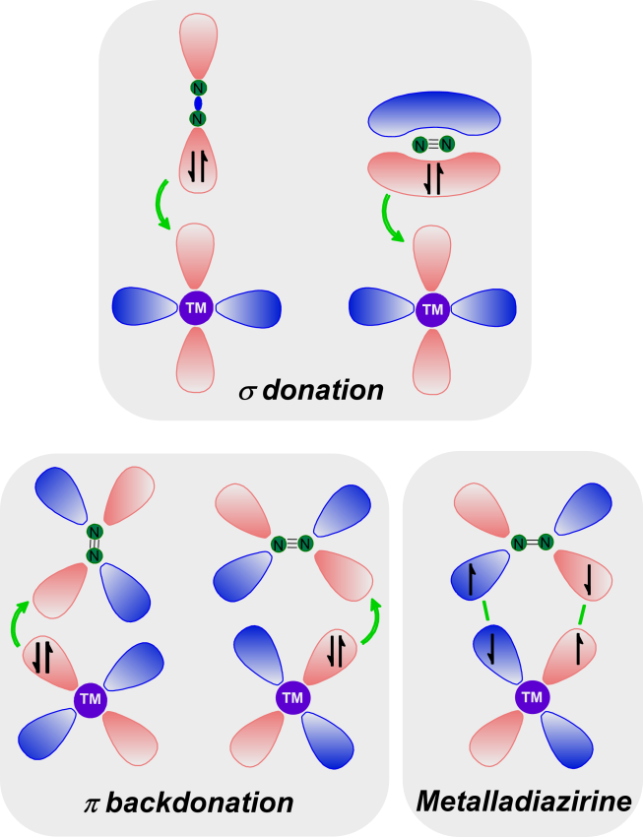
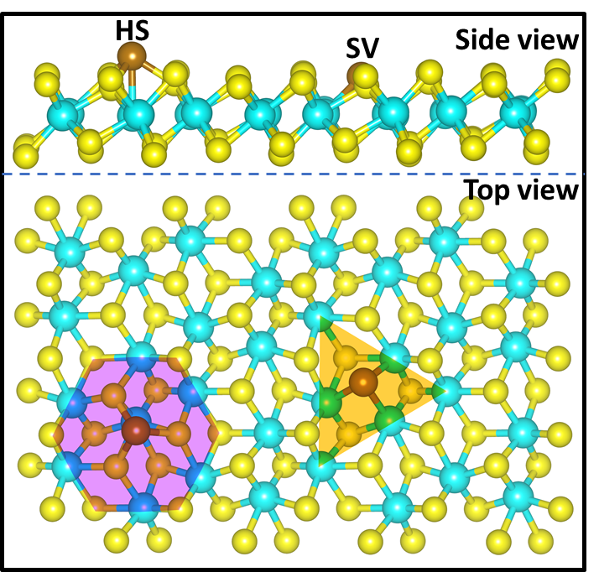

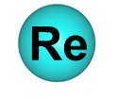

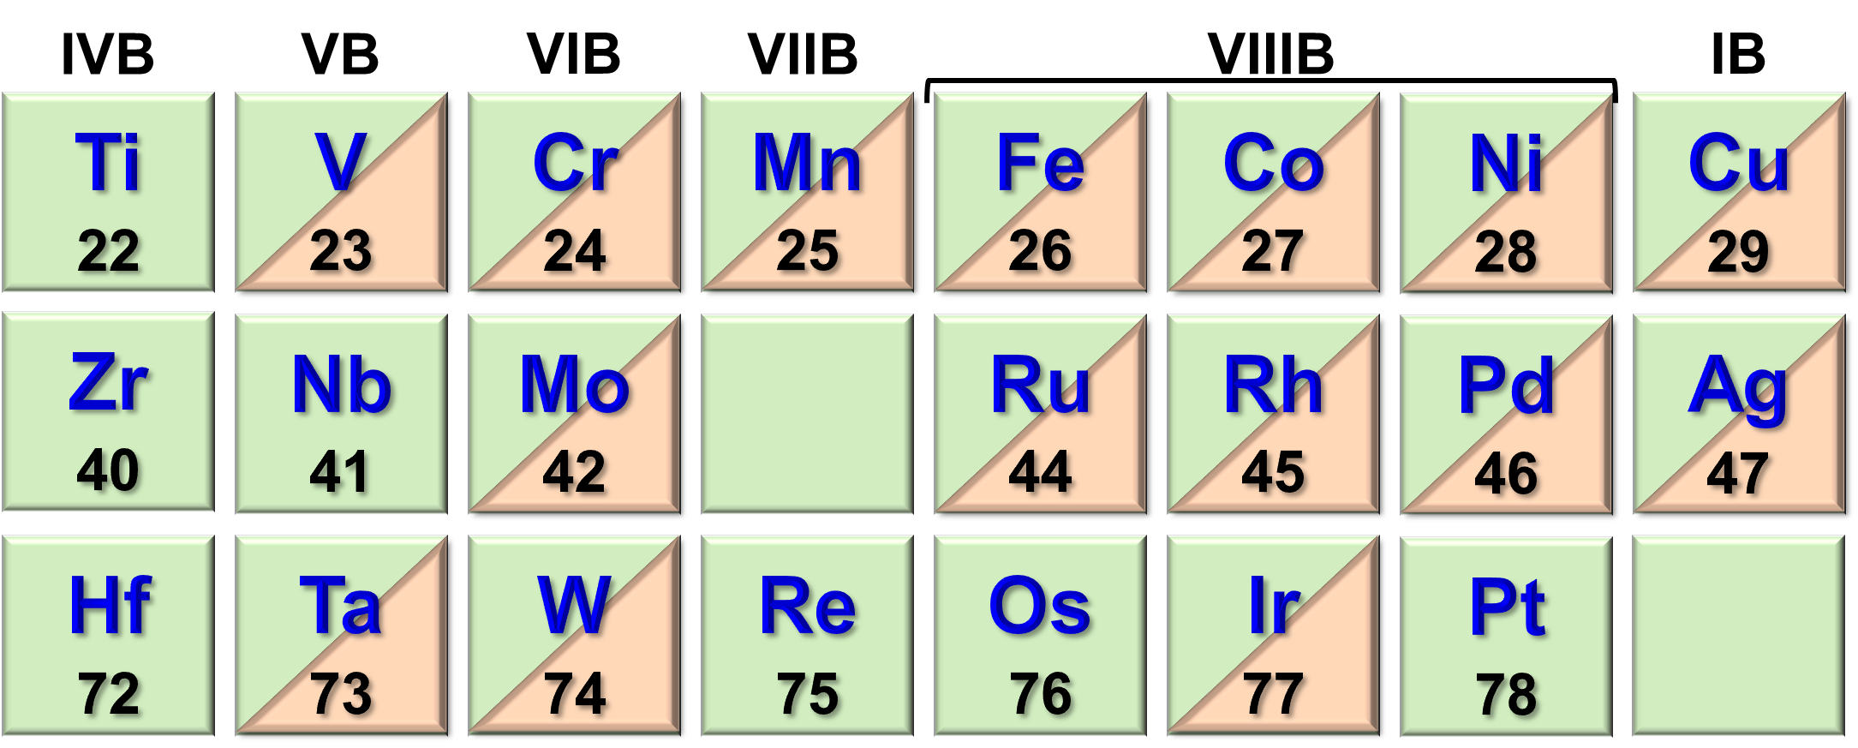

Slide 4
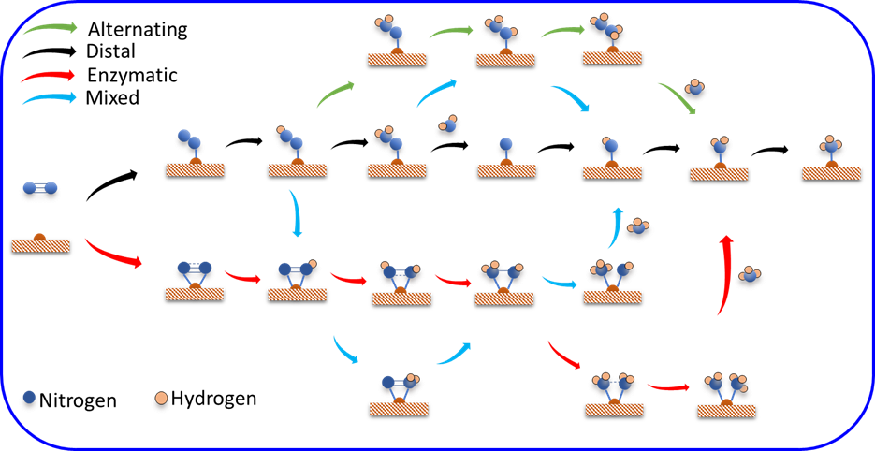

Slide 6
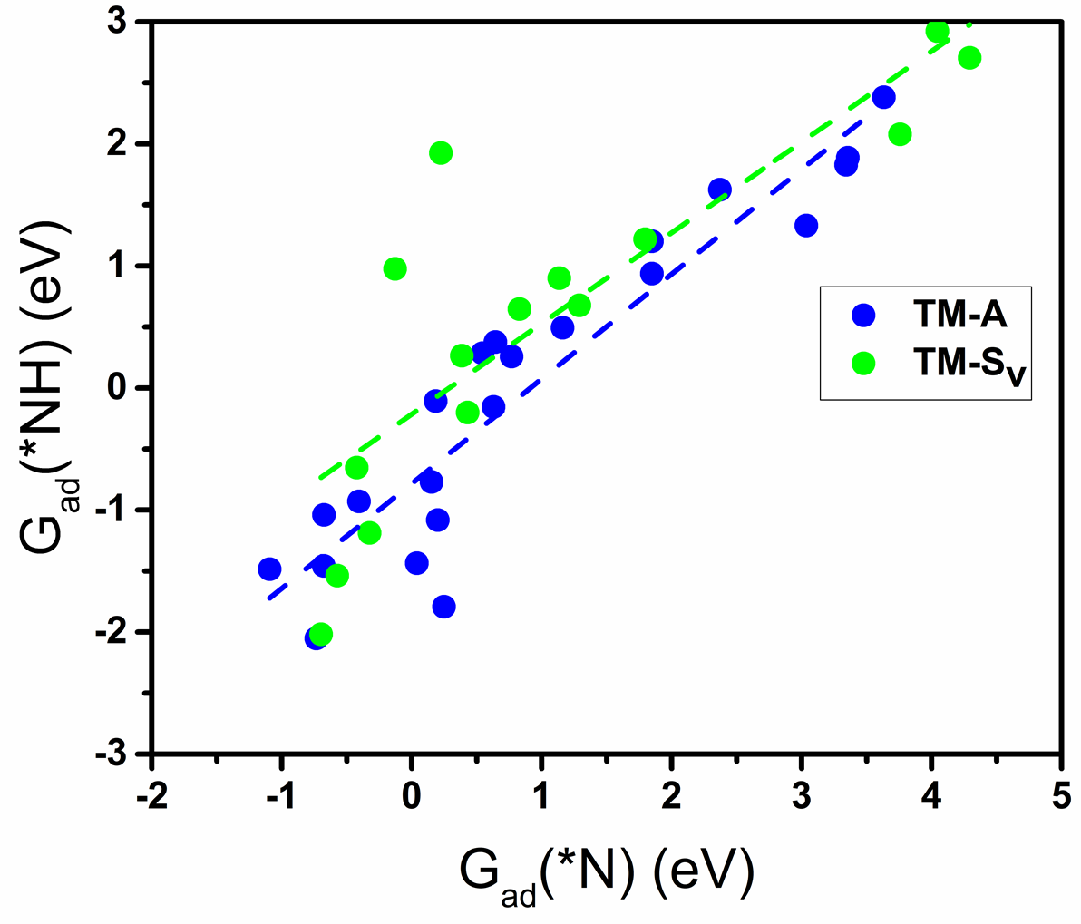

Slide 8
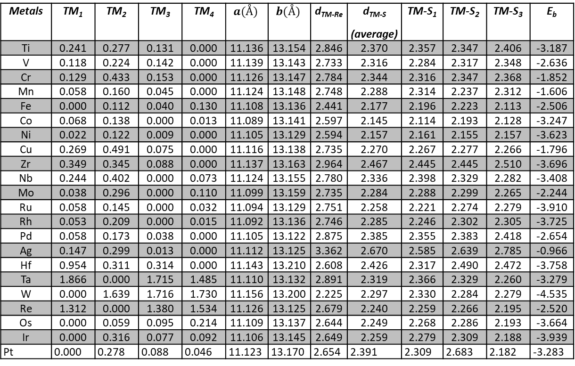
Metals | TM₁ | TM₂ | TM₃ | TM₄ | $$a(Å)$$ | $$b(Å)$$ | d_{TM-Re} | d_{TM-S} (average) | TM-S₁ | TM-S₂ | TM-S₃ | E_{b}
Ti | 0.241 | 0.277 | 0.131 | 0.000 | 11.136 | 13.154 | 2.846 | 2.370 | 2.357 | 2.347 | 2.406 | -3.187
V | 0.118 | 0.224 | 0.142 | 0.000 | 11.139 | 13.143 | 2.733 | 2.316 | 2.284 | 2.317 | 2.348 | -2.636
Cr | 0.129 | 0.433 | 0.153 | 0.000 | 11.126 | 13.147 | 2.784 | 2.344 | 2.316 | 2.347 | 2.368 | -1.852
Mn | 0.058 | 0.160 | 0.045 | 0.000 | 11.124 | 13.148 | 2.748 | 2.288 | 2.314 | 2.237 | 2.312 | -1.606
Fe | 0.000 | 0.112 | 0.040 | 0.130 | 11.108 | 13.136 | 2.441 | 2.177 | 2.196 | 2.223 | 2.113 | -2.506
Co | 0.068 | 0.138 | 0.000 | 0.013 | 11.089 | 13.141 | 2.597 | 2.145 | 2.114 | 2.193 | 2.128 | -3.247
Ni | 0.022 | 0.122 | 0.009 | 0.000 | 11.105 | 13.129 | 2.594 | 2.157 | 2.161 | 2.155 | 2.157 | -3.623
Cu | 0.269 | 0.491 | 0.075 | 0.000 | 11.116 | 13.138 | 2.735 | 2.270 | 2.267 | 2.277 | 2.266 | -1.796
Zr | 0.349 | 0.345 | 0.088 | 0.000 | 11.137 | 13.163 | 2.964 | 2.467 | 2.445 | 2.445 | 2.510 | -3.696
Nb | 0.244 | 0.402 | 0.000 | 0.073 | 11.124 | 13.155 | 2.780 | 2.336 | 2.398 | 2.329 | 2.282 | -3.408
Mo | 0.038 | 0.296 | 0.000 | 0.110 | 11.099 | 13.159 | 2.735 | 2.284 | 2.288 | 2.299 | 2.265 | -2.244
Ru | 0.058 | 0.145 | 0.000 | 0.032 | 11.094 | 13.129 | 2.751 | 2.258 | 2.221 | 2.274 | 2.279 | -3.910
Rh | 0.053 | 0.209 | 0.000 | 0.015 | 11.092 | 13.136 | 2.746 | 2.285 | 2.246 | 2.302 | 2.305 | -3.725
Pd | 0.058 | 0.173 | 0.038 | 0.000 | 11.105 | 13.122 | 2.875 | 2.385 | 2.355 | 2.383 | 2.418 | -2.654
Ag | 0.147 | 0.299 | 0.013 | 0.000 | 11.112 | 13.125 | 3.362 | 2.670 | 2.585 | 2.639 | 2.785 | -0.966
Hf | 0.954 | 0.311 | 0.314 | 0.000 | 11.143 | 13.210 | 2.608 | 2.426 | 2.317 | 2.490 | 2.472 | -3.758
Ta | 1.866 | 0.000 | 1.715 | 1.485 | 11.110 | 13.132 | 2.891 | 2.319 | 2.366 | 2.329 | 2.260 | -3.279
W | 0.000 | 1.639 | 1.716 | 1.730 | 11.156 | 13.200 | 2.225 | 2.297 | 2.330 | 2.284 | 2.279 | -4.535
Re | 1.312 | 0.000 | 1.380 | 1.534 | 11.126 | 13.125 | 2.679 | 2.240 | 2.259 | 2.266 | 2.195 | -2.520
Os | 0.000 | 0.059 | 0.095 | 0.214 | 11.109 | 13.137 | 2.644 | 2.249 | 2.268 | 2.286 | 2.193 | -3.664
Ir | 0.000 | 0.316 | 0.077 | 0.092 | 11.106 | 13.145 | 2.649 | 2.259 | 2.279 | 2.309 | 2.188 | -3.939
Pt | 0.000 | 0.278 | 0.088 | 0.046 | 11.123 | 13.170 | 2.654 | 2.391 | 2.309 | 2.683 | 2.182 | -3.283
Table S1.

Slide 9
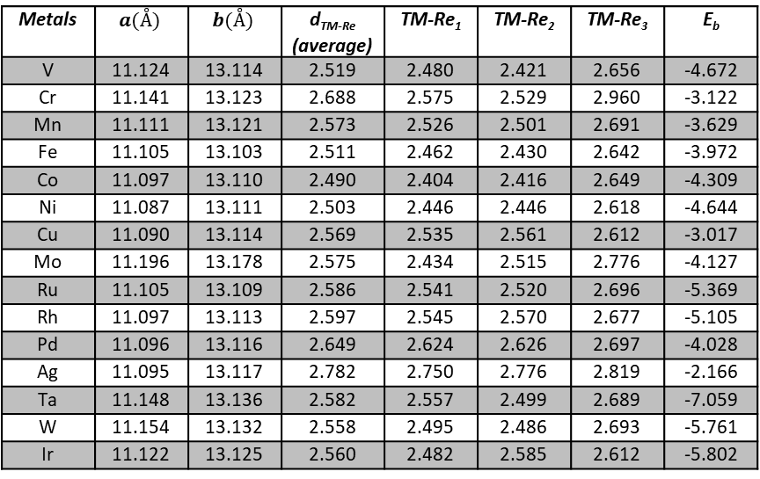
Metals | $$a(Å)$$ | $$b(Å)$$ | d_{TM-Re} (average) | TM-Re₁ | TM-Re₂ | TM-Re₃ | E_{b}
V | 11.124 | 13.114 | 2.519 | 2.480 | 2.421 | 2.656 | -4.672
Cr | 11.141 | 13.123 | 2.688 | 2.575 | 2.529 | 2.960 | -3.122
Mn | 11.111 | 13.121 | 2.573 | 2.526 | 2.501 | 2.691 | -3.629
Fe | 11.105 | 13.103 | 2.511 | 2.462 | 2.430 | 2.642 | -3.972
Co | 11.097 | 13.110 | 2.490 | 2.404 | 2.416 | 2.649 | -4.309
Ni | 11.087 | 13.111 | 2.503 | 2.446 | 2.446 | 2.618 | -4.644
Cu | 11.090 | 13.114 | 2.569 | 2.535 | 2.561 | 2.612 | -3.017
Mo | 11.196 | 13.178 | 2.575 | 2.434 | 2.515 | 2.776 | -4.127
Ru | 11.105 | 13.109 | 2.586 | 2.541 | 2.520 | 2.696 | -5.369
Rh | 11.097 | 13.113 | 2.597 | 2.545 | 2.570 | 2.677 | -5.105
Pd | 11.096 | 13.116 | 2.649 | 2.624 | 2.626 | 2.697 | -4.028
Ag | 11.095 | 13.117 | 2.782 | 2.750 | 2.776 | 2.819 | -2.166
Ta | 11.148 | 13.136 | 2.582 | 2.557 | 2.499 | 2.689 | -7.059
W | 11.154 | 13.132 | 2.558 | 2.495 | 2.486 | 2.693 | -5.761
Ir | 11.122 | 13.125 | 2.560 | 2.482 | 2.585 | 2.612 | -5.802
Table S2.

